Slide 1
MARKETING ANALYST
Referral Engagement Benchmark
Marketing Campaign Comparison
Modeled session duration by campaign and weekday
Source: tc-da-1.turing_data_analytics.raw_events
Notes:
Open with the business message: the goal is to decide which campaign signal is reliable enough for a marketing manager to use.

Slide 2
DECISION FRAME
Reliable Engagement Decision
The marketing manager needs weekday campaign trends with enough evidence to support action.
Referral traffic is consistently longer than organic traffic across the week.
Decision rule
Data Share Promo has the longest reliable weighted average, but a smaller sample.
Trust high-session patterns.
Use tiny samples as follow-up leads.
Black Friday and holiday spikes are interesting, but too small for strong claims.
Notes:
Explain the decision rule: a marketing analyst should not simply pick the tallest bar. We need enough sessions to trust a trend.

Slide 3
METRIC DESIGN
Session Modeling Logic
The raw events table does not include a ready-made session ID.
Raw events
Session flag
Modeled session
Summary
date, time,
user, campaign
new day or
30+ min gap
first event to
last event
campaign by
weekday
New session: different day or 30+ minute gap.
Duration: last event minus first event.
Modeled metric: explain limitations clearly.
Notes:
This slide teaches the session modeling logic. It also prepares the reviewer for questions about how time on site was interpreted.

Slide 4
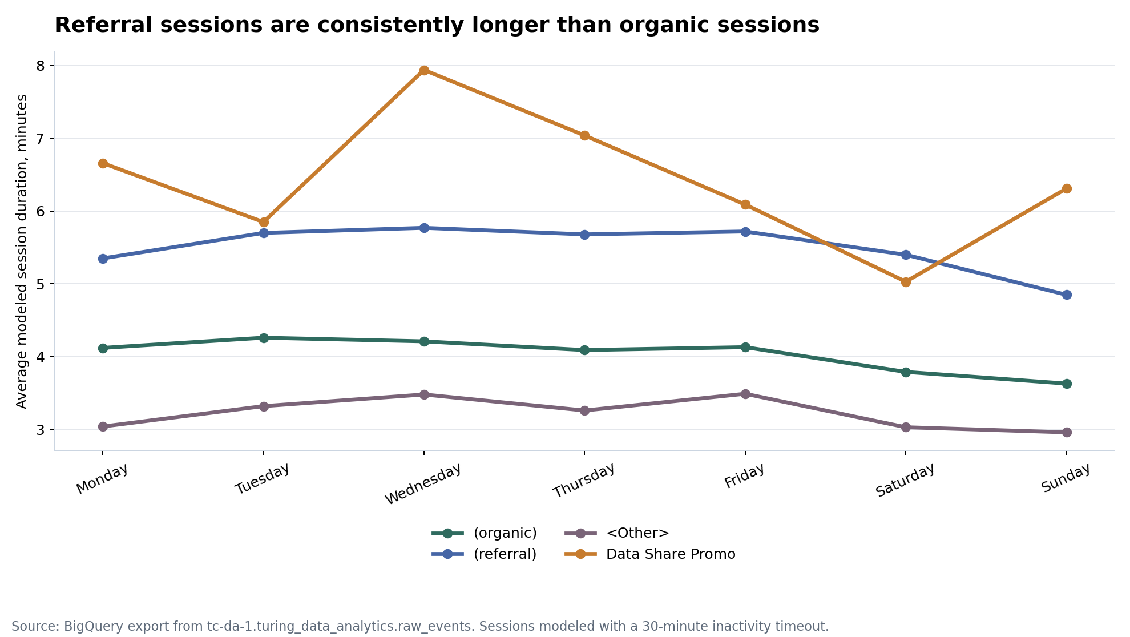
CORE PATTERN
Referral Duration Lead
In the reliable comparison set, referral stays above organic on every weekday.
Referral weighted average: 5.54 minutes.
Organic weighted average: 4.06 minutes.
Data Share Promo is higher overall, but less stable because the sample is smaller.
Notes:
Lead with the strongest visual evidence: referral is consistently above organic across weekdays.

Slide 5
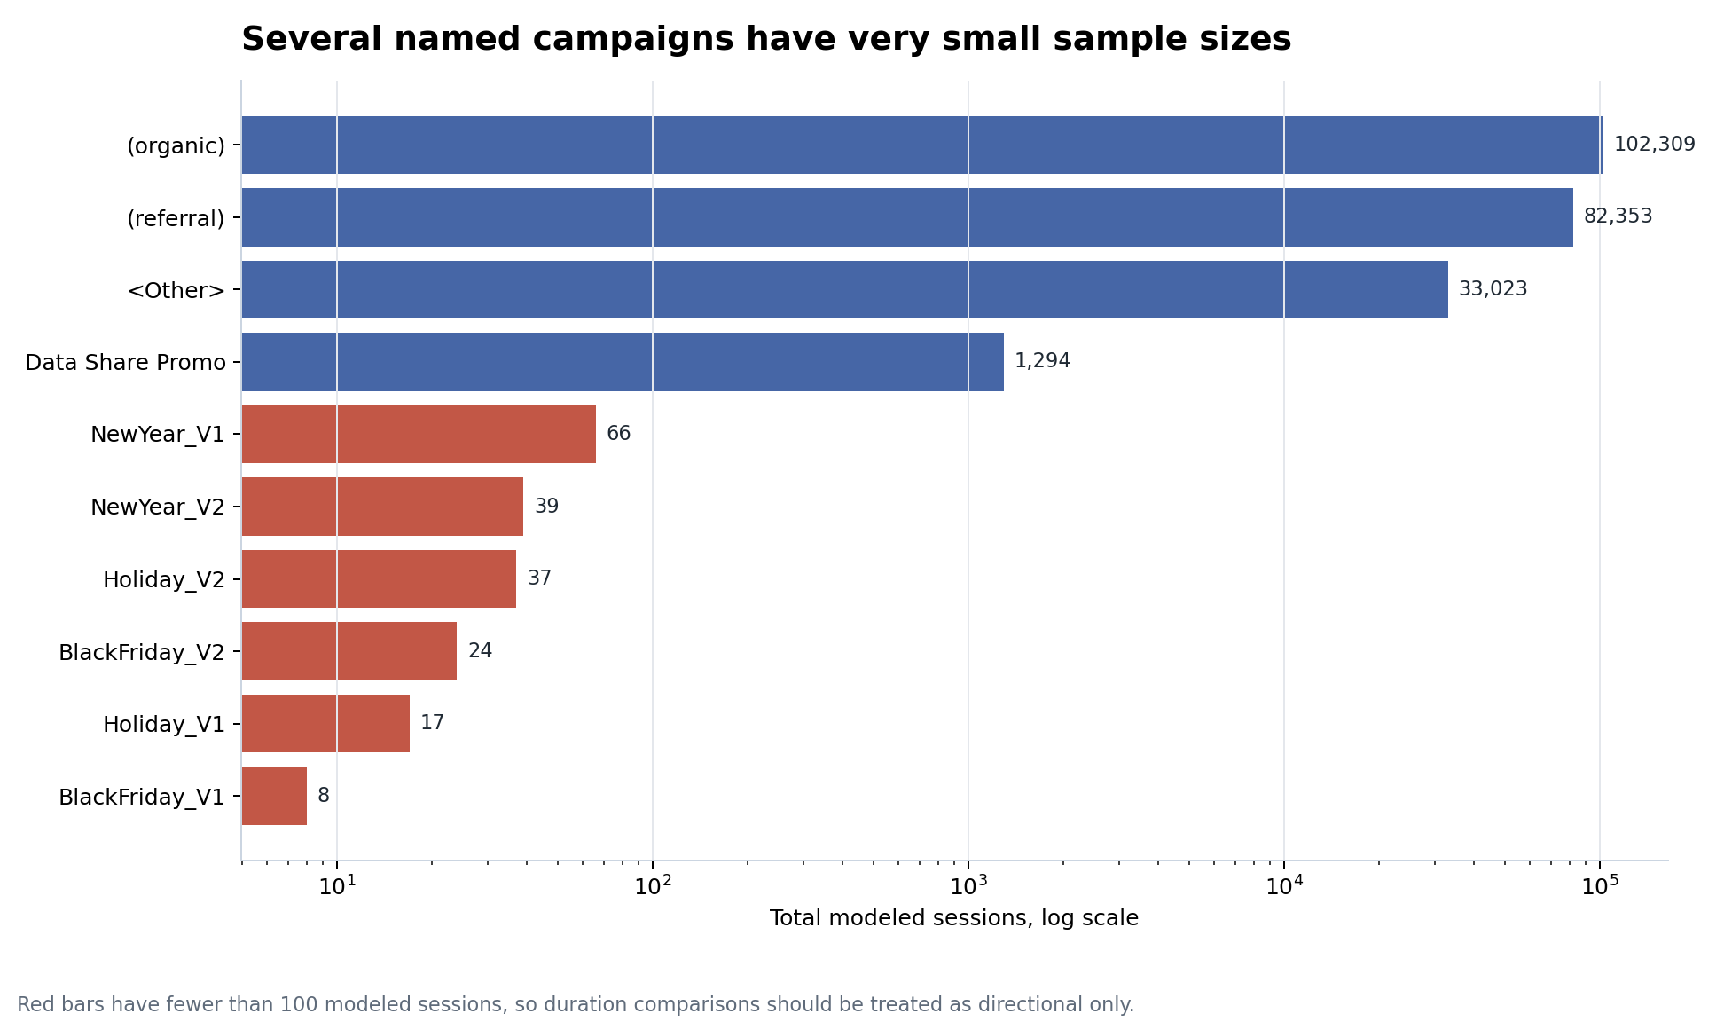
EVIDENCE WEIGHT
Sample Size Risk
Large session counts make organic and referral patterns much safer to interpret.
Organic: 102,309 modeled sessions.
Referral: 82,353 modeled sessions.
Data Share Promo: 1,294 modeled sessions.
Several named campaigns have fewer than 100 sessions.
Notes:
This slide is the evidence-quality slide. It prevents overclaiming small named campaigns.

Slide 6
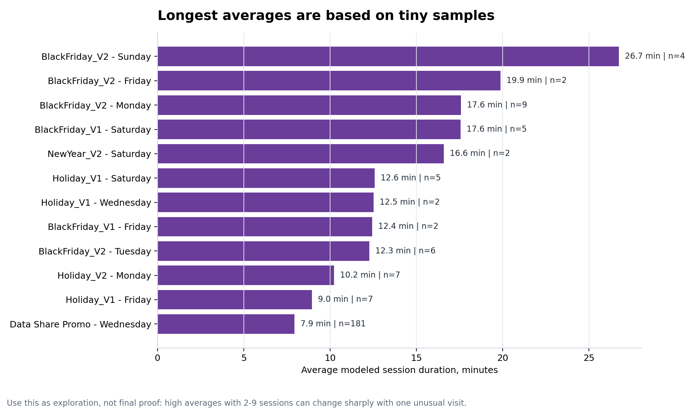
EXPLORATORY SIGNAL
Small-Sample Spikes
Most of the highest raw averages are based on 2-9 modeled sessions.
BlackFriday_V1
Friday
12.44 min
n = 2 sessions
Answer to review question: it did not take longer than 1 hour.
Notes:
Use this slide to answer the likely review question and explain why high averages from tiny samples are not enough for a budget decision.

Slide 7
INTERPRETATION
Duration Interpretation
Duration is a useful engagement signal, but it is not automatically a performance win.
Good interpretation
Risk interpretation
Stronger interest
Confusion
More product browsing
Friction
Better-fit traffic
Inactive browser tabs
Next decision should combine duration with purchases, revenue, and conversion rate.
Notes:
Explain that a longer session can mean engagement or friction. This is why the next analysis should connect duration to conversion and revenue.

Slide 8
LIMITATIONS
Modeling Limits
The analysis is useful for direction, but not causal proof of campaign quality.
Session IDs were not available, so sessions were estimated.
Single-event sessions have a duration of 0 minutes.
Campaign attribution may be incomplete when campaign values are missing.
Small campaign samples can move sharply with one unusual visit.
The analysis does not prove that longer sessions create more revenue.
Notes:
This slide shows analytical maturity. Name the assumptions and boundaries clearly so the reviewer knows you understand the metric.

Slide 9
ACTION PLAN
Outcome Follow-Up
Longer sessions matter most if they also lead to conversion or revenue.
1
Link to
revenue
2
Segment
traffic
3
Compare
median
Review zero-duration sessions separately.
Use real session IDs when available.
Treat small spikes as investigation leads.
Notes:
Turn the analysis into a practical next step. The marketing manager can use this to decide what to ask for next.

Slide 10
FINAL DECISION
Decision Summary
Use referral as the reliable benchmark and investigate Data Share Promo next.
Decision: compare future campaigns against referral's stable weekday engagement pattern.
Referral is the most dependable benchmark.
Data Share Promo needs conversion and revenue follow-up.
Tiny holiday samples are only investigation leads.
Notes:
Close with a clear decision summary. The project tells the manager what to trust and what to investigate next.

